Slide 1
Lecture 8: Evaluations
Instructor: Xiaobai Liu

Slide 2
Outline of today
Dataset: Training, testing, validation
Evaluation of Regression Problems
Evaluation of classification problems
Films from DARPA: https://youtu.be/-O01G3tSYpU

Slide 3
Outline of today
Dataset: Training, testing, validation
Evaluation of Regression Problems
Evaluation of classification problems

Slide 4
Dataset: training & testing
high_GPA | math_SAT | verb_SAT | comp_GPA | univ_GPA
3.45 | 643 | 589 | 3.76 | 3.52
2.78 | 558 | 512 | 2.87 | 2.91
2.52 | 583 | 503 | 2.54 | 2.4
3.67 | 685 | 602 | 3.83 | 3.47
3.24 | 592 | 538 | 3.29 | 3.47
2.1 | 562 | 486 | 2.64 | 2.37
2.82 | 573 | 548 | 2.86 | 2.4
2.36 | 559 | 536 | 2.03 | 2.24
2.42 | 552 | 583 | 2.81 | 3.02
3.51 | 617 | 591 | 3.41 | 3.32
3.48 | 684 | 649 | 3.61 | 3.59
2.14 | 568 | 592 | 2.48 | 2.54
2.59 | 604 | 582 | 3.21 | 3.19
3.46 | 619 | 624 | 3.52 | 3.71
3.51 | 642 | 619 | 3.41 | 3.58
3.68 | 683 | 642 | 3.52 | 3.4
3.91 | 703 | 684 | 3.84 | 3.73
3.72 | 712 | 652 | 3.64 | 3.49
2.15 | 564 | 501 | 2.14 | 2.25
2.48 | 557 | 549 | 2.21 | 2.37
3.09 | 591 | 584 | 3.17 | 3.29
2.71 | 599 | 562 | 3.01 | 3.19
2.46 | 607 | 619 | 3.17 | 3.28
3.32 | 619 | 558 | 3.01 | 3.37
3.61 | 700 | 721 | 3.72 | 3.61
3.82 | 718 | 732 | 3.78 | 3.81
2.64 | 580 | 538 | 2.51 | 2.4
2.19 | 562 | 507 | 2.1 | 2.21
3.34 | 683 | 648 | 3.21 | 3.58
Features
Predictions
Training
Testing

Slide 5
validation
high_GPA | math_SAT | verb_SAT | comp_GPA | univ_GPA
3.45 | 643 | 589 | 3.76 | 3.52
2.78 | 558 | 512 | 2.87 | 2.91
2.52 | 583 | 503 | 2.54 | 2.4
3.67 | 685 | 602 | 3.83 | 3.47
3.24 | 592 | 538 | 3.29 | 3.47
2.1 | 562 | 486 | 2.64 | 2.37
2.82 | 573 | 548 | 2.86 | 2.4
2.36 | 559 | 536 | 2.03 | 2.24
2.42 | 552 | 583 | 2.81 | 3.02
3.51 | 617 | 591 | 3.41 | 3.32
3.48 | 684 | 649 | 3.61 | 3.59
2.14 | 568 | 592 | 2.48 | 2.54
2.59 | 604 | 582 | 3.21 | 3.19
3.46 | 619 | 624 | 3.52 | 3.71
3.51 | 642 | 619 | 3.41 | 3.58
3.68 | 683 | 642 | 3.52 | 3.4
3.91 | 703 | 684 | 3.84 | 3.73
3.72 | 712 | 652 | 3.64 | 3.49
2.15 | 564 | 501 | 2.14 | 2.25
2.48 | 557 | 549 | 2.21 | 2.37
3.09 | 591 | 584 | 3.17 | 3.29
2.71 | 599 | 562 | 3.01 | 3.19
2.46 | 607 | 619 | 3.17 | 3.28
3.32 | 619 | 558 | 3.01 | 3.37
3.61 | 700 | 721 | 3.72 | 3.61
3.82 | 718 | 732 | 3.78 | 3.81
2.64 | 580 | 538 | 2.51 | 2.4
2.19 | 562 | 507 | 2.1 | 2.21
3.34 | 683 | 648 | 3.21 | 3.58
training
validation

Slide 6
Outline of today
Dataset: Training, testing, validation
Evaluation of Regression Problems
Evaluation of classification problems
Over-fitting problems

Slide 7
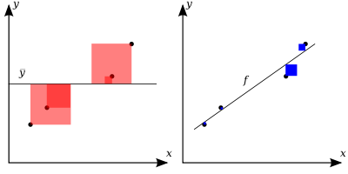
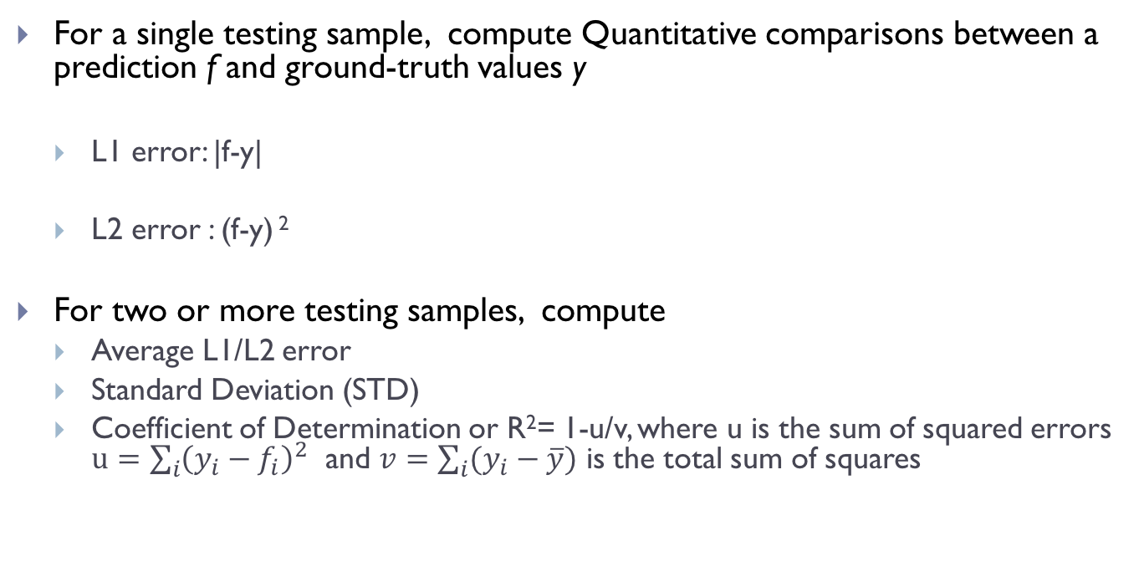
Metric
For a single testing sample, compute Quantitative comparisons between a prediction f and ground-truth values y
L1 error: |f-y|
L2 error : (f-y) ²
For two or more testing samples, compute
Average L1/L2 error
Standard Deviation (STD)
Coefficient of Determination or R²= 1-u/v, where u is the sum of squared errors $u=\sum_{i}{{\left(y_{i}−f_{i}\right)}^{2}}$ and $v=\sum_{i}{(y_{i}−\overline{y})}$ is the total sum of squares
The better the linear regression (on the right) fits the data in comparison to the simple average (on the left graph), the closer the R2 value is to 1.
Notes:
(1 - u/v), where u is the residual sum of squares ((y_true - y_pred) ** 2).sum() and v is the total sum of squares ((y_true - y_true.mean()) ** 2).sum()

Slide 8
Validation Error
Split the training dataset in to two subsets
Training
Validation
Generating multiple splitting
Apply the above metrics over every split.
Getting rid of random effects.
Cross-validation

Slide 9
Outline of today
Dataset: Training, testing, validation
Evaluation of Regression Problems
Evaluation of classification problems
Over-fitting problems

Slide 10
Two terms
In training &testing of a binary model , a sample might be ‘positive’ or ‘negative’
Positive: Cat
Negative: dog
In evaluation, the prediction of a sample could be
“ True” or “false”
True: same with ground-truth label
False: other wise

Slide 11
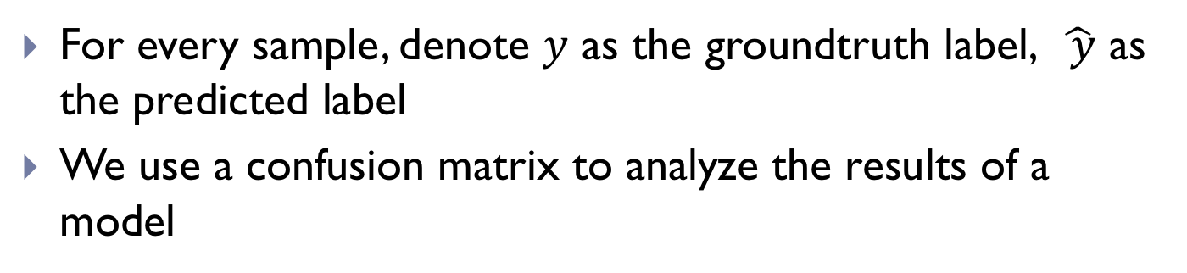
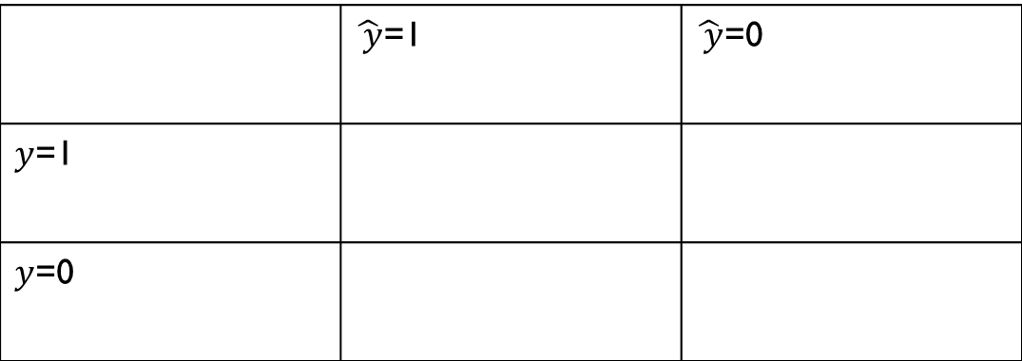
Binary classification
For every sample, denote $y$ as the groundtruth label, $\hat{ y}$ as the predicted label
We use a confusion matrix to analyze the results of a model
Prediction
 | $\hat{ y}$=1 | $\hat{ y}$=0
$y$=1
$y$=0
Groundtruth
True-positive
False- Negative
False-positive
True-negative

Slide 12
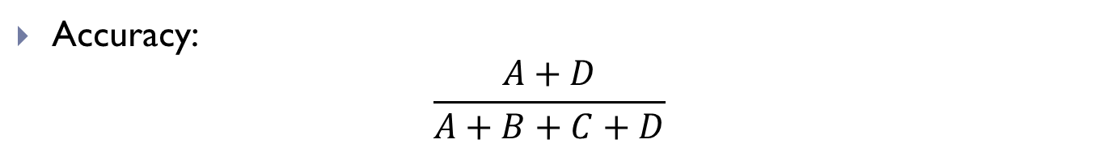
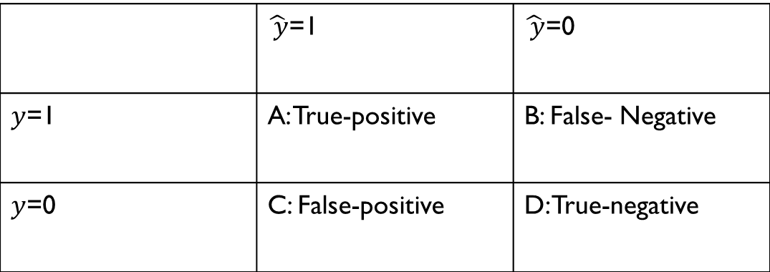
metrics
Prediction
 | $\hat{ y}$=1 | $\hat{ y}$=0
$y$=1 | A: True-positive | B: False- Negative
$y$=0 | C: False-positive | D: True-negative
Groundtruth
Accuracy:
$$\frac{A+D}{A+B+C+D}$$

Slide 13
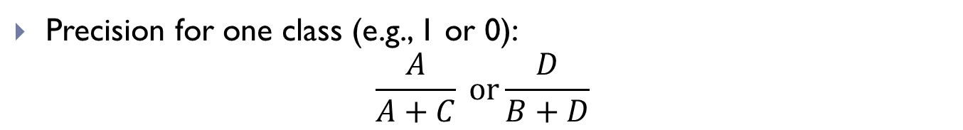
metrics
Prediction
 | $\hat{ y}$=1 | $\hat{ y}$=0
$y$=1 | A: True-positive | B: False- Negative
$y$=0 | C: False-positive | D: True-negative
Groundtruth
Precision for one class (e.g., 1 or 0):
$$\frac{A}{A+C} or\frac{D}{B+D}$$

Slide 14

metrics
Prediction
 | $\hat{ y}$=1 | $\hat{ y}$=0
$y$=1 | A: True-positive | B: False- Negative
$y$=0 | C: False-positive | D: True-negative
Groundtruth
Recall for one class ( 1 or 0):
$$\frac{A}{A+B} or\frac{D}{C+D}$$

Slide 15
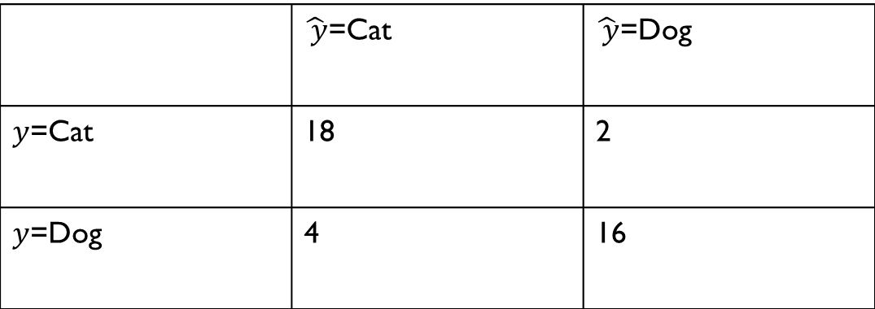
Quiz: binary-classification
Prediction
 | $\hat{ y}$=Cat | $\hat{ y}$=Dog
$y$=Cat | 18 | 2
$y$=Dog | 4 | 16
Groundtruth
The classification results of animal photos are summarized in the above table. What’re the accuracy, precision and recall?

Slide 16
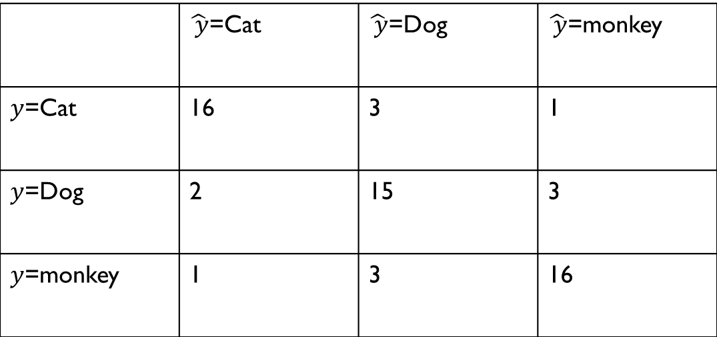
Quiz: multi-class classification
Prediction
 | $\hat{ y}$=Cat | $\hat{ y}$=Dog | $\hat{ y}$=monkey
$y$=Cat | 16 | 3 | 1
$y$=Dog | 2 | 15 | 3
$y$=monkey | 1 | 3 | 16
Groundtruth
The classification results of animal photos are summarized in the above table. What’re the accuracy, precision and recall?

